Slide 1
Theory of Automata
Lecture # 06
Dr. Muhammad Fayaz

Slide 2
Some More Examples

Slide 3
Example
. (b*aab*)*

Slide 4
Example
(b*aab*ab*ba*)*

Slide 5
Practice
b* + (a(a+b)*b)*

Slide 6
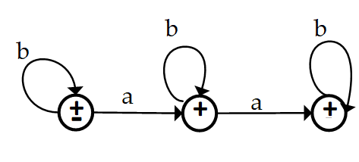
Example:
( x ). b* + b*ab* + b*aab*

Slide 7
Example:
( x ). ((a + b)(a + b)(a + b))*

Slide 8
Example:
a((a + b)(a + b)(a + b))*b

Slide 9
Deterministic Finite Automata (DFA) and Non-Deterministic Finite Automata (NFA)

Slide 10
DFA and NFA
DFA:
For every state q in S and every character α in Σ, one and only one transition of the following form occurs:
a , b
a , b
Σ=(a , b)
-
+
NFA:
For every state q in S and every character α in Σ ∪ {e}, one (or both) of the following will happen:
Λ
occurs
Empty transition:
-
+
a
occurs
More than one transitions on same alphabet:
-
+
All these are not allowed in DFA
a
+
a
…
Only one transition:
-
+

Slide 11
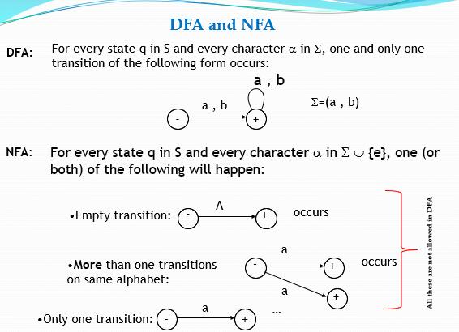
Example-NFA
Regular Expression = b(a + b)* , may be accepted by the following NFA
a,b
––
b
+

Slide 12
Example-NFA
Example:
Regular Expression: Λ + (a + b)*a
a,b
––
a
+
Λ
+

Slide 13
Example:
Regular Expression = a ((a + b)(a + b))*
NFA
In order to covert the above NFA to DFA a new state namely dead state is introduced.
DFA
13
Dead State

Slide 14
Example:
(a+ b)*aa (a + b)*
NFA
a, b
b
a
a
-
+
DFA
b

Slide 15
Example:
Regular Expression = b*aa b*
NFA
a, b
b
a
a
-
+
DFA
15
In order to covert the above NFA to DFA a new state namely dead state is introduced.
b
a, b
Dead State

Slide 16
Example:
Regular Expression = b* + b*ab* + b*aa b*
b
b
b
NFA
+
a
a
-
+
+
b
b
b
+
a
a
-
+
+
DFA
16
In order to covert the above NFA to DFA a new state namely dead state is introduced.
a
a
a, b
Dead State

Slide 17
Example:
Regular Expression = b (a + b)*
a,b
––
b
+
a,b
a
DFA
Dead State
Regular Expression = b(a + b)*

Slide 18
Example:
Regular Expression = ((a + b)(a + b))*
a, b
x ±
y
a, b
DFA
18

Slide 19
Example:
Regular Expression = (a + b)((a + b)(a + b))*
a , b
–
+
a, b
DFA

Slide 20
Practice:
Regular Expression = (a + b)*a

Slide 21
Example:
Regular Expression = a (a + b)* b + b (a + b)* a
a
b
b
2
4+
a
a
1–
b
a
a
b
5+
3
b

Slide 22
Example:
Regular Expression = (a + b)* aa (a + b)*
b
a,b
a
2
a
1-
3+
DFA
b

Slide 23
Example: Regular Expression =(a + b)* aa (a + b)* + (a + b)*bb (a + b)*
x
a
a
a , b
-
a
b
+
b
b
y
DFA

Slide 24
Example:
Regular Expression = (a + b)* bbb ( a + b )*+ (a + b)* aaa ( a + b )*
2
a
4
a
a
a,b
a,b
1–
6+
b
b
NFA
3
b
5

Slide 25
Example:
Regular Expression = (a + b)* bbb ) ( a + b )*+ (a + b)* aaa ( a + b )*
2
a
4
a
a
b
a,b
1––
a
b
6+
b
a
b
DFA
3
b
5

Slide 26
Example:
Regular Expression = (a + b) + a(a + b)*a + b(a + b)*b
a
a
b
a
b
+
+
a
b
1–
b
b
a
b
b
a
+
+
DFA
a

Slide 27
Example
Consider the EVEN-EVEN language, defined over Σ={a, b}.
EVEN-EVEN language can be expressed by the regular expression
Regular Expression=(aa+bb+(ab+ba)(aa+bb)*(ab+ba))*

Slide 28
Example:
Regular Expression=(aa+bb +(ab+ba)(aa+bb)*(ab+ba))*
b
1±
3
b
a
a
a
a
b
2
4
b

Slide 29
Thanks

